Slide 1

OS Lab
Instructor
Saba Naseem
saba.naseem@nu.edu.pk

Slide 2

Introduction to Posix threads
What is a thread?
A sequence of machine instructions.
The smallest unit of processing that a scheduler works on.
Threads and processes -
A process (created by a fork() command) can have multiple threads of execution which are executed asynchronously.
Every process has at least one thread

Slide 3
What is a Thread?
▪A thread is a semi-process, that has its own stack, and executes a given piece of code.
▪Threads is also called lightweight processes since a thread is "lighter weight" than a process.
▪ That is, thread creation can be 10–100 times faster than process creation
▪ Unlike a real process, the thread normally shares its memory with other threads (where as for
processes we usually have a different memory area for each one of them)
▪A Thread Group is a set of threads all executing inside the same process.
▪ They all share the same memory, and thus can access the same global variables, same heap
memory, same set of file descriptors, etc. All these threads execute in parallel

Slide 4
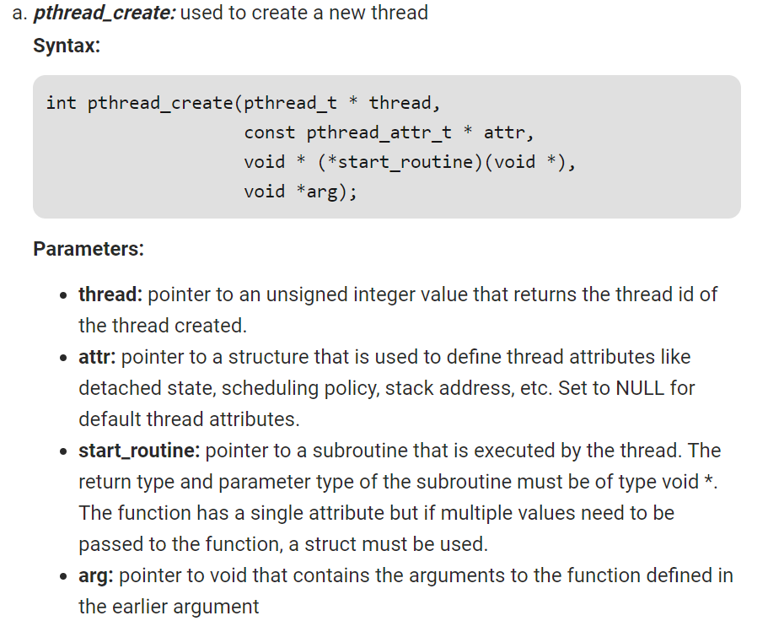

Slide 5
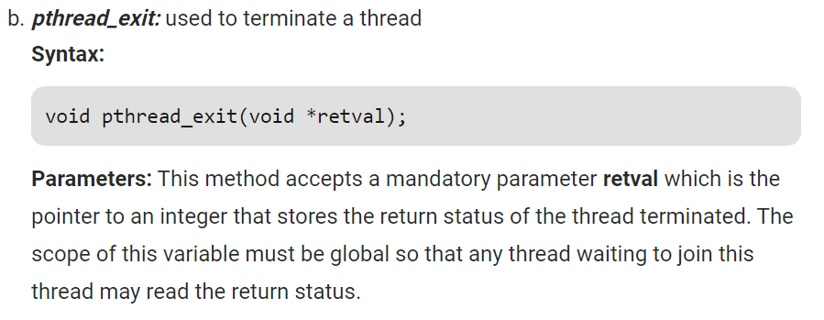

Slide 6
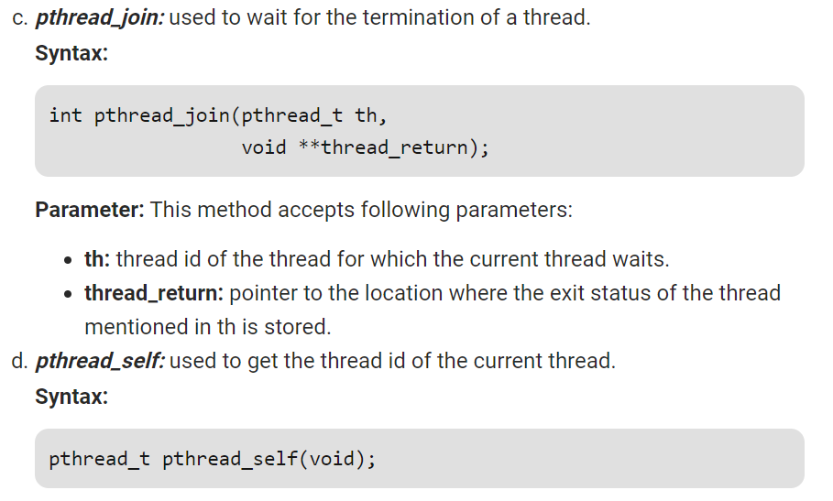

Slide 7
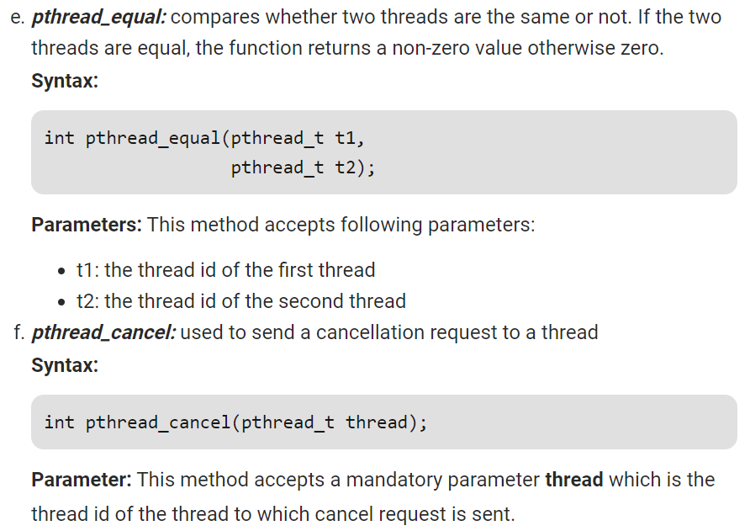

Slide 8
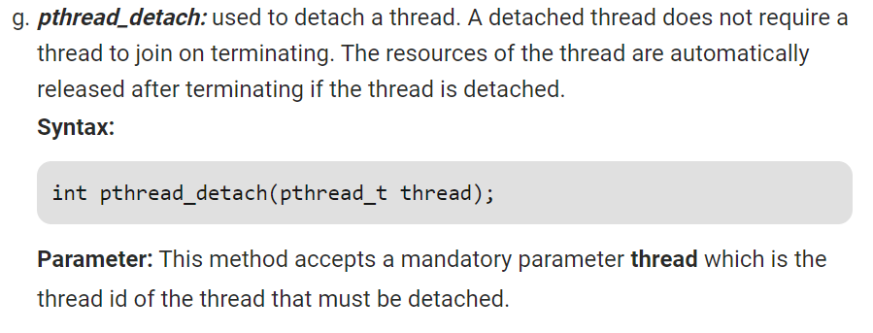

Slide 9
Needed Library And How To Compile And Execute File In Linux.
#include<pthread.h>
For C language>>> gcc filename.c –lpthread
For C++ language>>> g++ filename.cpp –lpthread
Exeute it with>> ./a.out
Or follow the given link on classroom

Slide 10
EXAMPLE

Slide 11
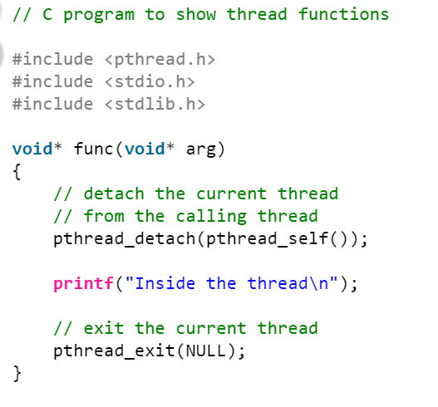
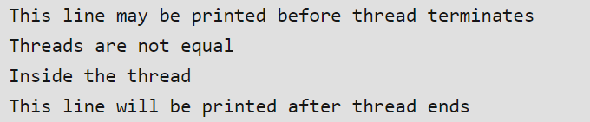
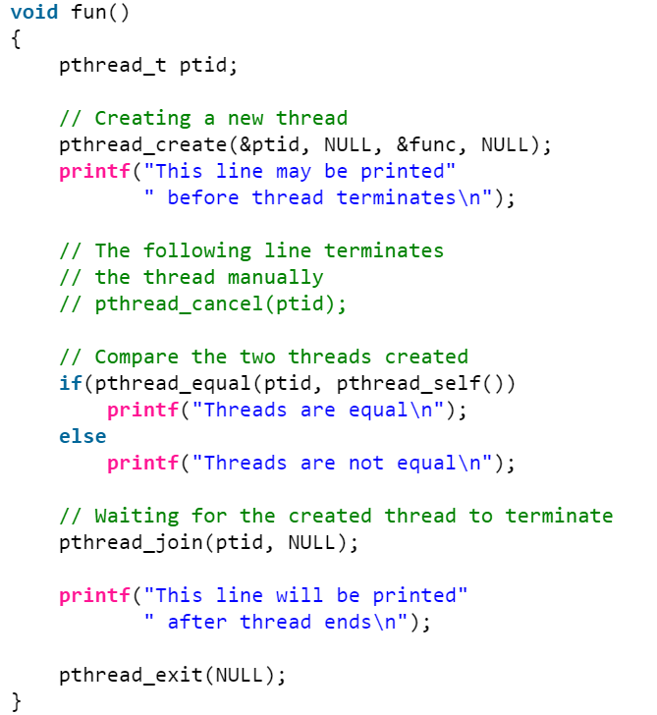
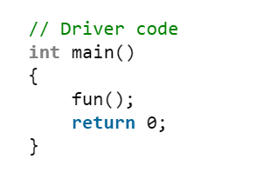

Slide 12
ASSIGNMENT AHEAD☺
GOOD LUCK!!!

Slide 13
